Slide 1
Data Analytics Capstone
By William Jarosz
Notes:
Hello, my name is William Jarosz, and this is my Data Analytics Capstone Project.

Slide 2
Introduction
Notes:
For this project I wanted to work with something that would be relevant to my career, Information Security, so I began looking for datasets that I could work with it relating to that. This inevitably brought me to a website called, privacyrights.org, that brings together publicly reported data breach notifications from across the U.S.

Slide 3
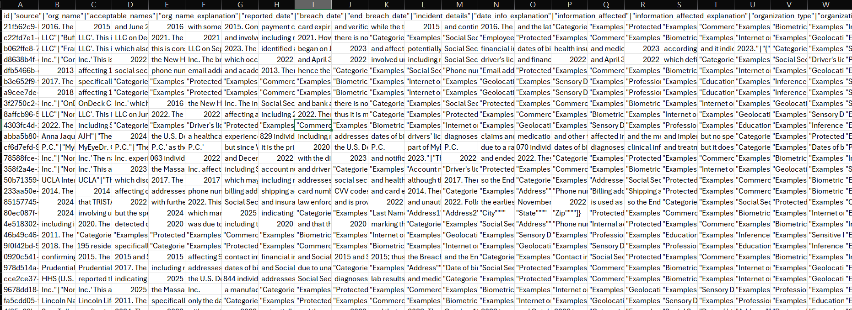
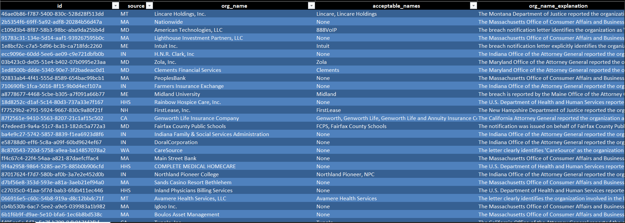
Reviewing my dataset
Notes:
Unfortunately, the data didn’t come in a format that allowed me to do much of anything with, so I had to clean up and parse out columns so I could determine if I was going to be able to craft and answer questions regarding breaches. Fortunately, there did appear to be a format to the data. Essentially there were pipes acting as delimiters but most of it was all in one column with some misc. information that needed to be removed here and there. Once I was able to set the delimiter to pipe in excel and delete out the misc. rows the data become much easier to review and craft my questions. The picture on the left is the uncleaned data and the data on the right has been cleaned and ready to work with.

Slide 4
Intro
My Questions
What is the average breach time by organization type?
What types of personal data are commonly involved in breaches, and can we predict which category a breach belongs to based on the text description?
What state has the most data breaches and what state has the most data breaches per 100,000 people.
Notes:
The questions I came to ask are the following. What is the Average Breach time by Organization type? What types of personal data are commonly involved in breaches, and can we predict which category a breach belongs to based on the text description? What state has the most data breaches and what state has the most data breaches per 100,000 people.

Slide 5
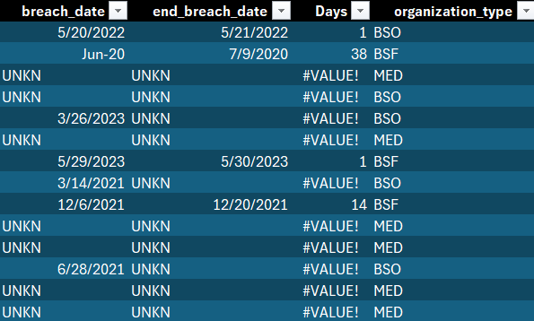
What is the average breach time by organization type?
Notes:
So now that I have my questions in order, I need to start trying to answer them. The first one was straight forward. I took the columns breach date and end breach date and calculated the difference to make a column called days and then associated each row to the organization type. There was some information that was missing in certain cells so if I wasn’t able to derive a value for certain breaches they where omitted from the chart.

Slide 6
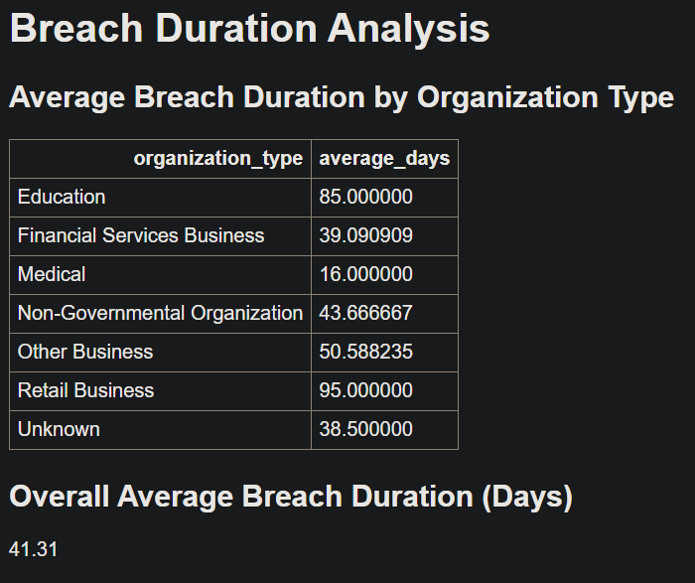
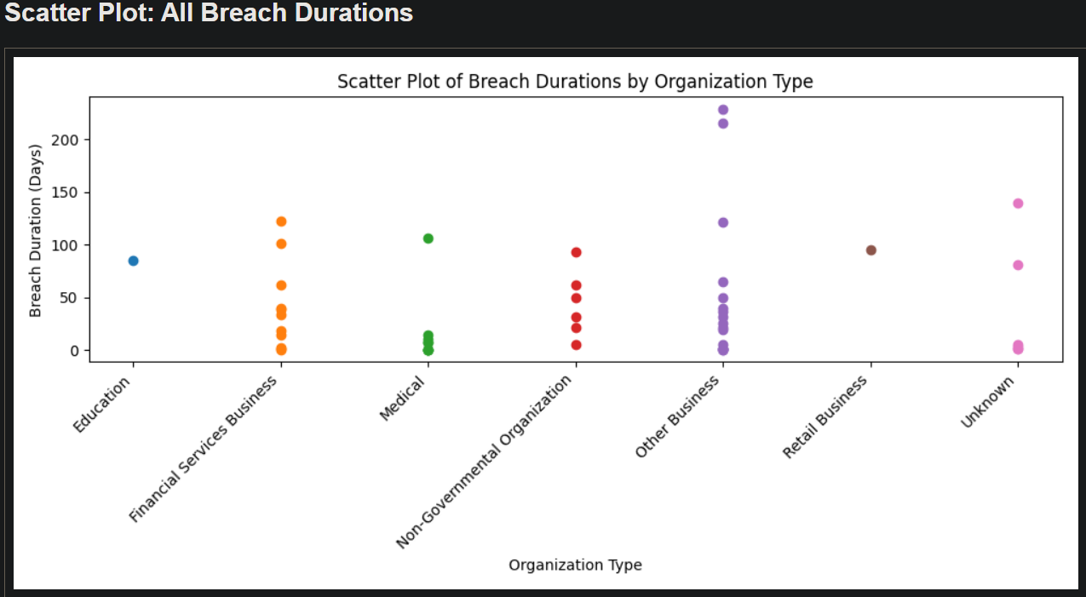
Average Breach Duration by Organization Type
Notes:
Once this excel file was created, I was then able to use this as my data set to create a table with the average breach time in days by org, the average breach time across my entire dataset and a scatter plot showing all the breach times. According to the data the longest breach time was an average of 95 days belonging to Retail Businesses. That being said there was only 1 reported breach in this category with enough information provided that could be added to this table and chart so a larger dataset may show otherwise. The lowest average breach time was in the Medical industry. This makes sense as well because there are strict regulations in the medical field that require this kind of data to be monitored for HIPAA compliance and similar regulations. Overall, from the information provided the average breach duration came out to be 41 and 31 hundredth days which roughly equates to just under 41 days, 7 hours and 30 minutes. I was actually surprised by this and thought the average would have been much higher than this.

Slide 7
What types of personal data are commonly involved in breaches?
Can we predict which category a breach belongs to based on the text description using the keyword list we’ve created so far?
Notes:
Now on to the data classification. What types of personal data are commonly involved in breaches and Can we predict which category a breach belongs to based on the text description using the keyword list we’ve created so far? For this one I had to classify the custom strings column I had from my original dataset into data types that could be more easily expressed visually.

Slide 8
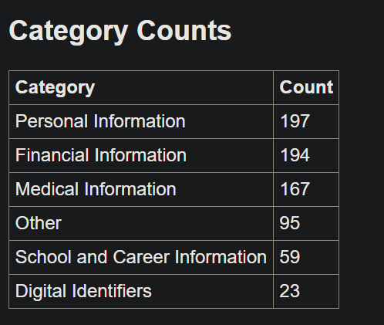
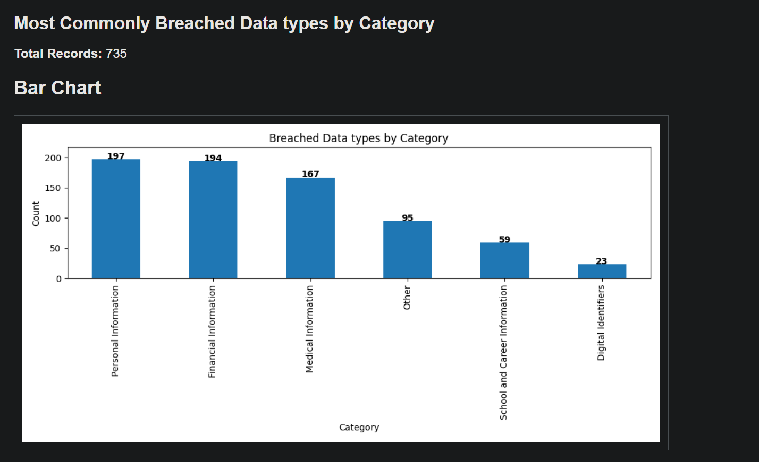
Keyword Categorizing
Notes:
I worked with the PingPong chatbot to create some broad categories and keywords associated with those categories to filter the data types. The categories I chose were Personal Information, Financial Information, Medical Information, School and Career information, Digital Identifiers and Other. I felt like this gave us a nice diverse set of categories we could use to easily align our keywords with. As we can see from the data Personal Information was the most prominent category that we saw with Financial Information very close behind and Medical Information not to far off either. With this one there is some room for speculation because Personal information can sometimes have some overlap with Medical information, but I felt it best to categorize with no overlap and keep medical entirely related to medical and not other forms of personal identifiable information that some may say are medical, but are often used in Personal information like DOB, fingerprint, and Race as some examples.

Slide 9
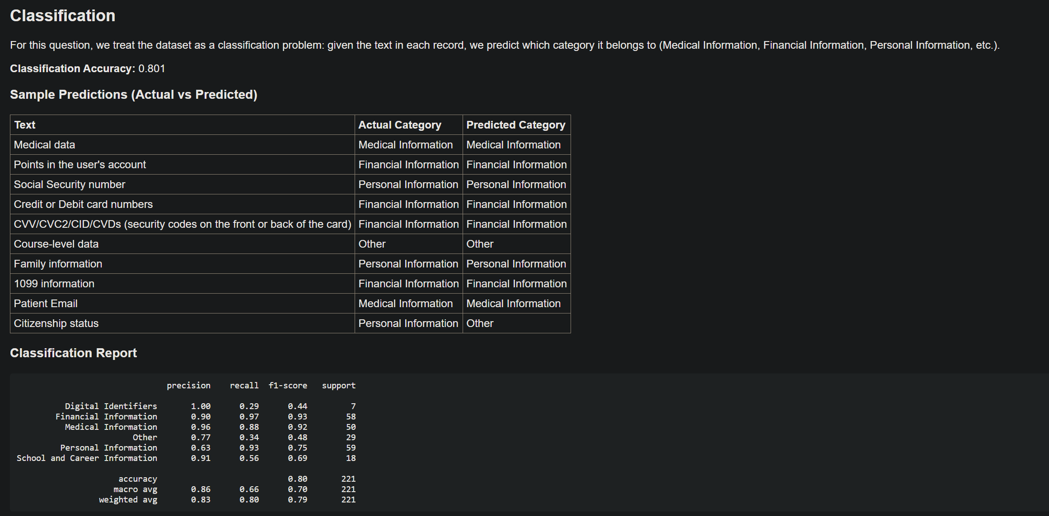
Notes:
I then used keyword-based rules to generate training labels, then trained a supervised machine-learning classifier on that labeled data. This proved to be reasonable but would definitely use improvement as you can see in the data. With accuracy in certain categories dropping quite low because of lack of training data while other categories at a more acceptable rate presumably because they had more information to train on.

Slide 10
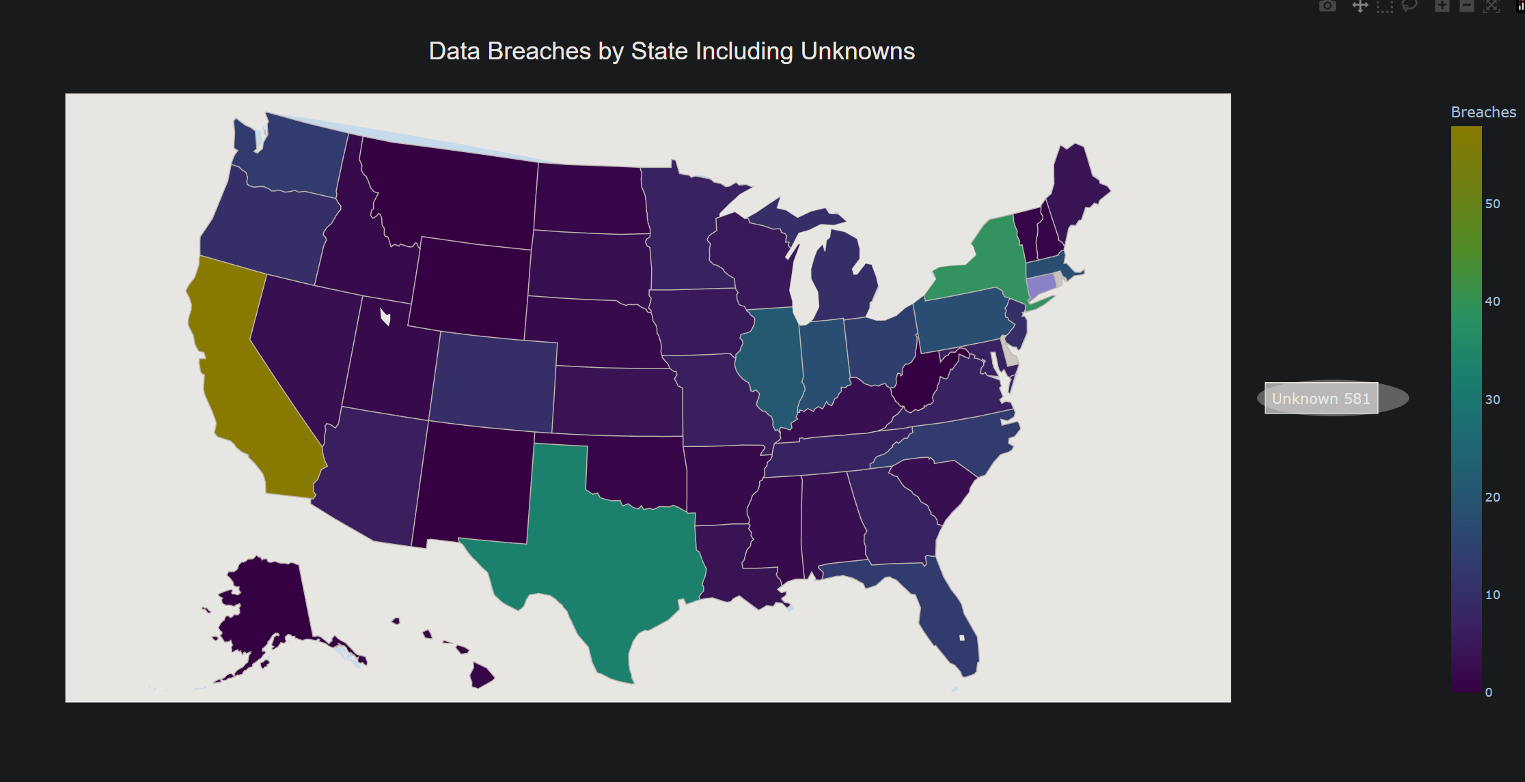
What state has the most data breaches?
What state has the most data breaches per 100,000 people?
Notes:
Which brings us to our final questions. What state has the most data breaches and what state has the most data breaches per 100,000 people?

Slide 11
Notes:
For this one I took the breach location state column to count how many breaches occur per state and plot them onto this Choropleth map. If you were to hover over the map you would see the count for each state, but you can get a generally idea of the most affected states based on the colors. I also have stated the number of unknown locations being 581 because certain cells lacked adequate information to determine state of origin for the breach. The state with the most breaches was California with 58, New York is number 2 with 41, and Texas is number 3 with 33. I didn’t have really any predications on this going into things but seeing this makes sense because California and Texas have the largest populations and New York have a rather large population on top of a having the New York Stock exchange and acting as a global financial mecca.

Slide 12
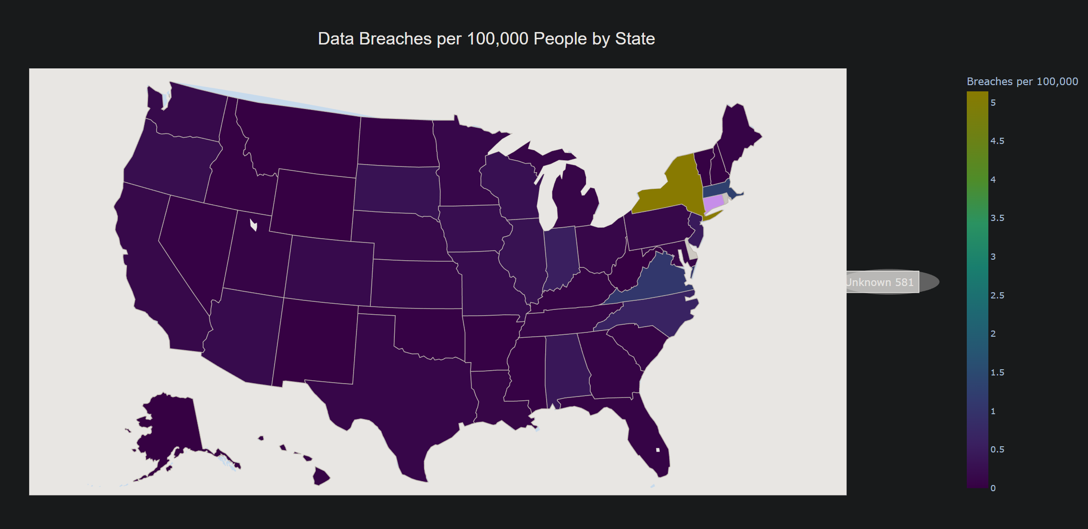
Notes:
I then copied and adjusted my original map and factored in how many people per 100 thousand to see if this would yield different results and it did. California and Texas were no longer anywhere near the top of the list. Instead for data breaches per 100 thousand people New York is clearly number one with over 5 data breaches per 100 thousand people. This is almost 5 times any other state when it comes to data breaches. As stated, prior with New York being a global financial mecca one could assume that plays at least a small part of why this could be the case. In second we have Massachusetts with 1 and 28 hundredth of a breach per 100 thousand people, and Virginia takes the 3rd spot with 1 and 7 hundredth of a breach taking place per 100 thousand people.

Slide 13
Average Breach Time
Keyword Classifier
Data Breaches per State
Data Breaches per State per 100 thousand People
Notes:
Here is a link to all of my graphs, charts, and maps. I was able to take the python code and output an html file for each question which I was then able to host on github pages so my data can be viewed from anywhere by anyone.

Slide 14
Thank you
Notes:
Thank you for your time!

